Slide 1

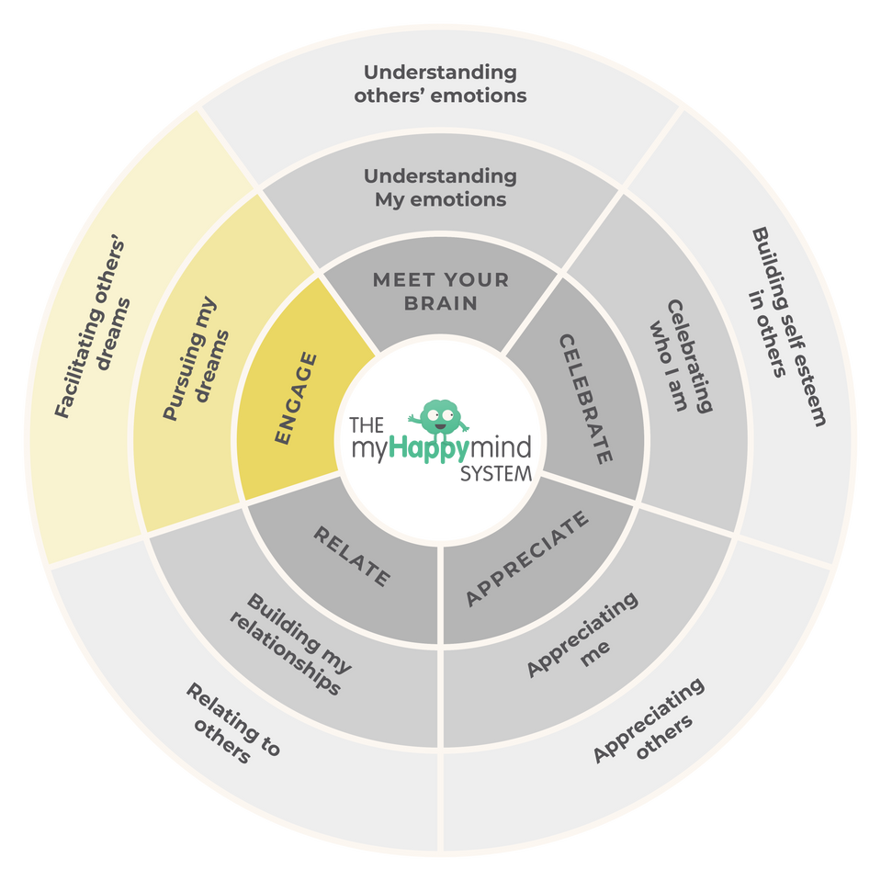
Engage
We have just come to the end of the last module - ‘Engage’ in the myHappymind programme.
We have learnt:
  Why it is important to have goals that we are passionate about.
  How to set our own goals.
  That when we feel good, we do good.
2

Slide 2
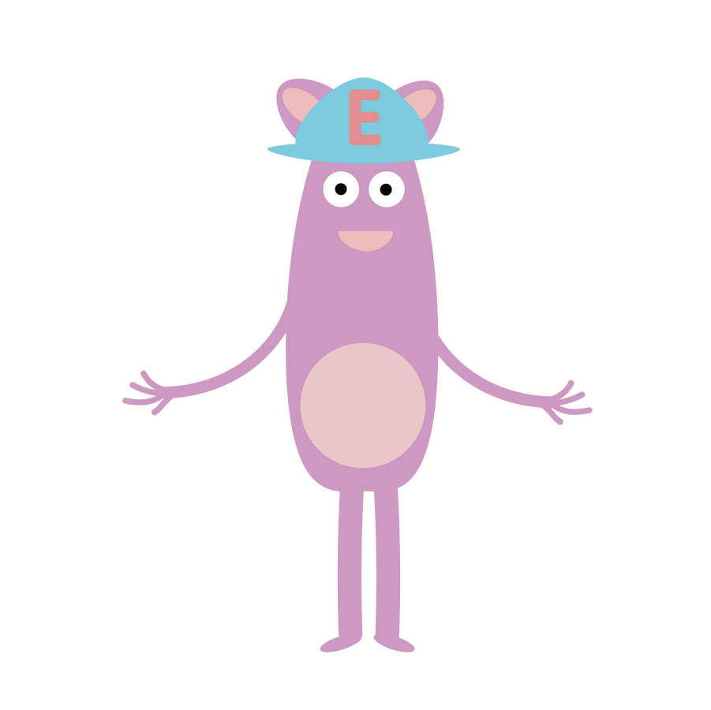
Engage
Why not ask your children to tell you what they have learnt?
Here are some questions to help you:
What is a Big Dream Goal and what is yours?
What are 3 steps to set a goal?
Do setting goals help you to feel good?
3

Slide 3

Support your child at home
Log onto the parent app for more information about the Engage module and how you can support your child at home.
There are lots of activites you can do together including listening to the story and song, plus much more.
There is a whole Kid’s Zone for your child to enjoy with interactive games. As well as resources for grown-ups too.
myHappymind for Parents
Educate yourself
Learn all about what your children are learning in school
Exclusively for parents with children at a myHappymind School or Nursery.
To access the materials just go to https://myhappymind.org/parent-resources and enter your name, email and authentication code.
(Please contact your school for your authentication code.)
4

