Slide 1
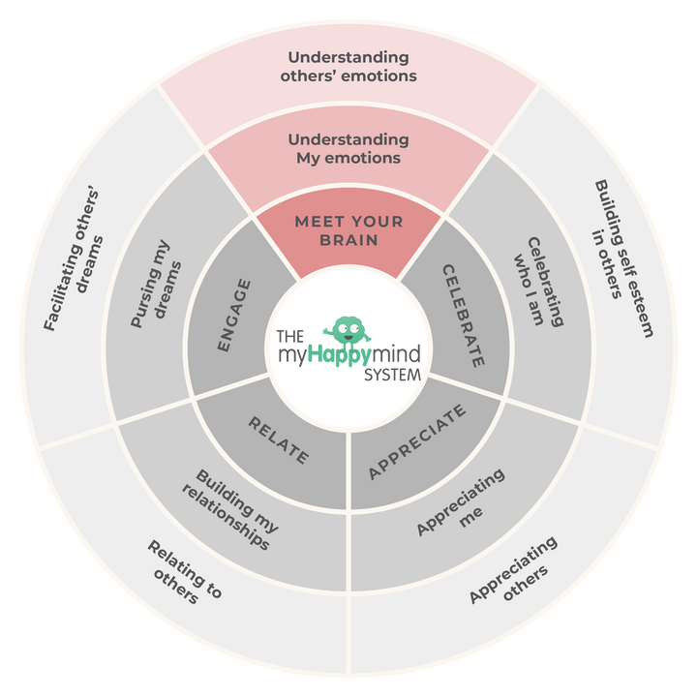
Meet Your Brain
We have just come to the end of the first module - ‘Meet Your Brain’ in the myHappymind programme.
We have learnt:
  The different parts of our brain and how they help us.
  How to use Happy Breathing to help us when we feel sad, stressed or worried.
  What happens in our brain when we learn something new and how we can look after our brain.
2

Slide 2
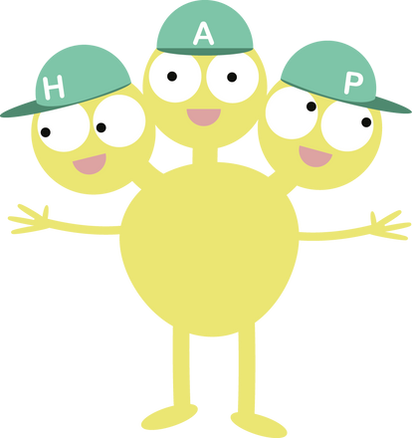
Meet Your Brain
Why not ask your children to tell you what they have learnt?
Here are some questions to help you:
Who is Team H-A-P?
Can you tell me about the Team in your brain?
Can you tell me what Neuroplasticity means?
When has your brain grown?
Why does Happy Breathing
help you and when could
you use it?
3

Slide 3

Support your child at home
Log onto the parent app for more information about the Meet Your Brain module and how you can support your child at home.
There are lots of activities you can do together including Happy Breathing and making a Glitter Jar, listening to the story and song, plus much more.
myHappymind for Parents
Educate yourself
Learn all about what your children are learning in school
Exclusively for parents with children at a myHappymind School or Nursery.
To access the materials just go to https://myhappymind.org/parent-resources and enter your name, email and authentication code.
(Please contact your school for your authentication code.)
4

