Slide 1

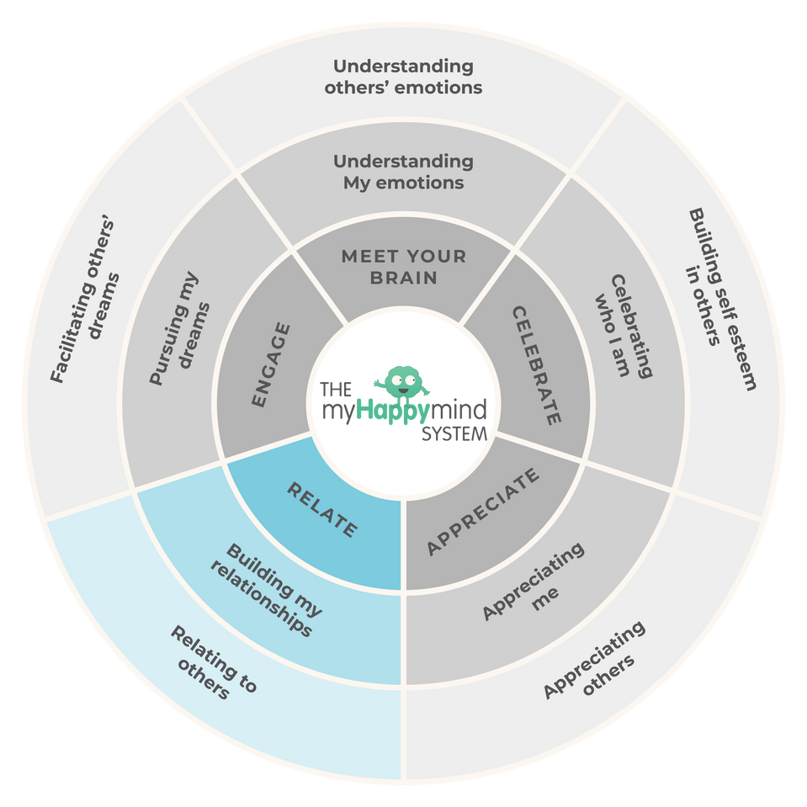
Relate
We have just come to the end of the Relate module in the myHappymind programme.
We have learnt:
  Why relating to others is so important.
  How Active Listening can help us to build relationships with other people.
  How to see things from a different perspective.
2

Slide 2
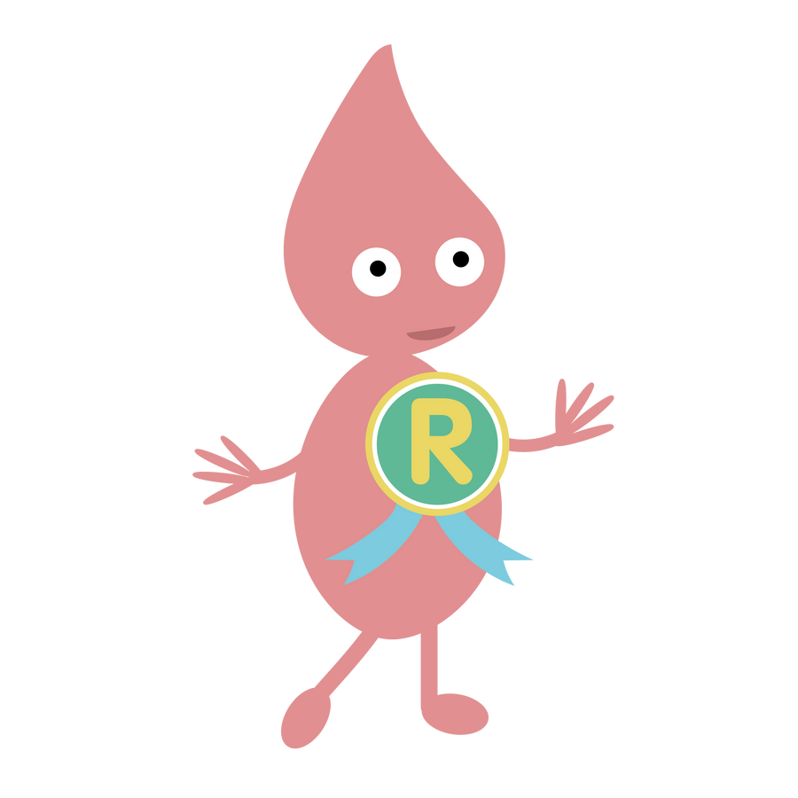
Relate
Why not ask your children to tell you what they have learnt?
Here are some questions to help you:
What is Active Listening? Can you tell me about the Active Listening checklist?
Can our Character Strengths help us relate and get along with others?
Why is it important to listen to others and see things from their perspective?
3

Slide 3

Support your child at home
Log onto the parent app for more information about the Relate module and how you can support your child at home.
There are lots of activites you can do together including listening to the story and song, plus much more.
There is a whole Kid’s Zone for your child to enjoy with interactive games. As well as resources for grown-ups too.
myHappymind for Parents
Educate yourself
Learn all about what your children are learning in school
Exclusively for parents with children at a myHappymind School or Nursery.
To access the materials just go to https://myhappymind.org/parent-resources and enter your name, email and authentication code.
(Please contact your school for your authentication code.)
4

