Slide 1

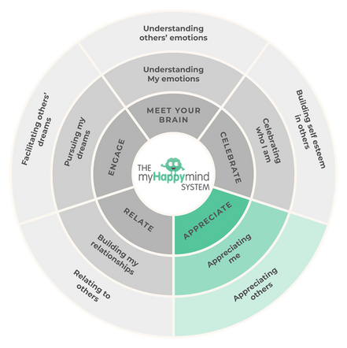
Celebrate
Celebrate
Appreciate
We have just come to the end of the Appreciate module in the myHappymind programme.
We have learnt:
  How to develop an Attitude of Gratitude
  How to be grateful for others, experiences and ourselves.
  How giving and receiving gratitude makes us feel.
2

Slide 2
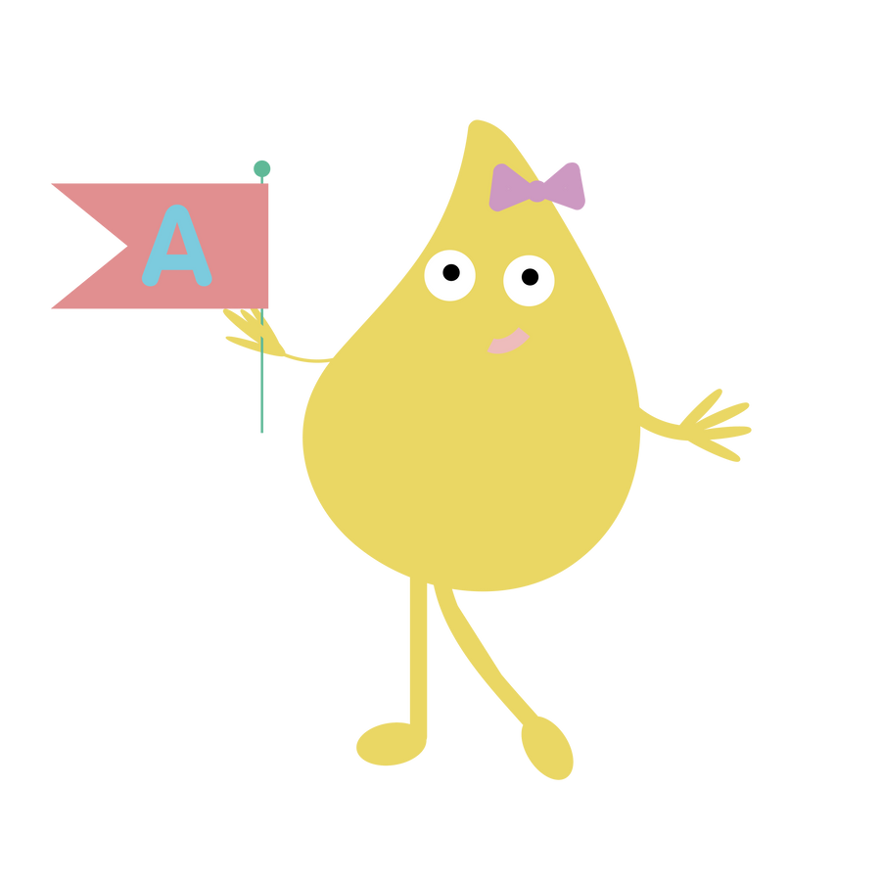
Appreciate
Why not ask your children to tell you what they have learnt?
Here are some questions to help you:
What have you been grateful for today and how did you show it?
What are the three categories on the Wheel of Gratitude?
How does it make you feel when you give or receive gratitude?
3

Slide 3

Support your child at home
Log onto the parent app for more information about the Appreciate module and how you can support your child at home.
There are lots of activities you can do together including creating a thankful tree, listening to the story and song, plus much more.
There is a whole Kid’s Zone for your child to enjoy with interactive games. As well as resources for grown-ups too.
myHappymind for Parents
Educate yourself
Learn all about what your children are learning in school
Exclusively for parents with children at a myHappymind School or Nursery.
To access the materials just go to https://myhappymind.org/parent-resources and enter your name, email and authentication code.
(Please contact your school for your authentication code.)
4

