Slide 1
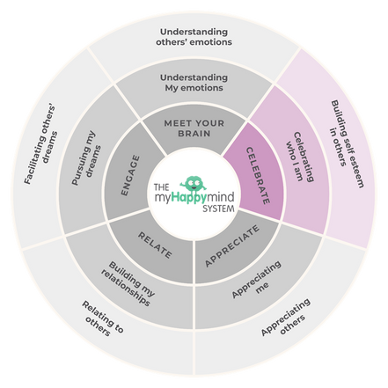
Celebrate
Celebrate
We have just come to the end of the Celebrate module in the myHappymind programme.
We have learnt:
  What Character Strengths are and why they matter.
  How to recognise Character Strengths in ourselves.
  How understanding Character Strengths can make us feel.
2

Slide 2
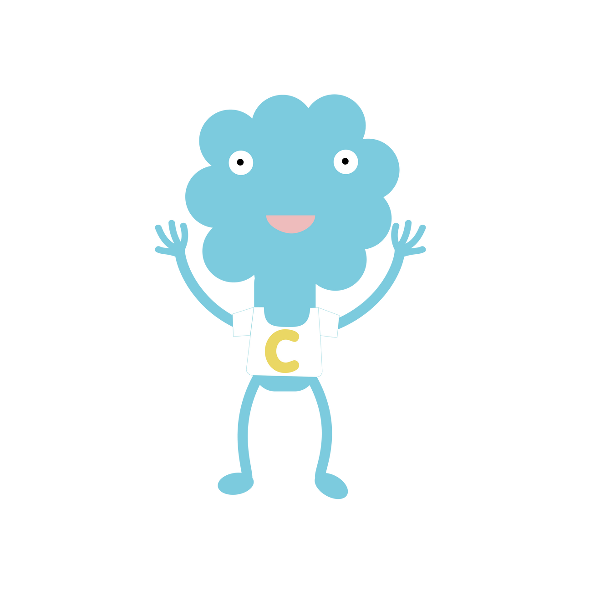
Celebrate
Celebrate
Why not ask your children to tell you what they have learnt?
Here are some questions to help you:
What is your top Character Strength?
Which strength would you like to grow and use more?
Why is it important to spot Character Strengths in other people?
3

Slide 3

Support your child at home
Log onto the parent app for more information about the Celebrate module and how you can support your child at home.
There are lots of activites you can do together including creating strength spotting glasses, listening to the story and song plus much more.
There is a whole Kid’s Zone for your child to enjoy with interactive games. As well as resources for grown-ups too.
Educate yourself
myHappymind for Parents
Learn all about what your children are learning in school
Exclusively for parents with children at a myHappymind School or Nursery.
To access the materials just go to https://myhappymind.org/parent-resources and enter your name, email and authentication code.
(Please contact your school for your authentication code.)
4

